Slide 1
Using Vector Quantization for Machine Learning Classification Projects
Joe Everton
May 21, 2019

Slide 2
Introducing: Joe Everton
Software Engineer
Principal Consultant at SoftSource Consulting
Worked in many domains
Factory automation
3D graphics tools
Online game
Aviation
Machine learning and data science.

Slide 3

Introducing: SoftSource Consulting
Small consulting business right here in Tigard.
We work on all kinds of software
Modern Web
Mobile
Game Engine / VR
Embedded
Cloud
Successful projects with all sorts of clients
Sports apparel
Famous online CCG
Aviation

Slide 4
SoftSource, Continued
Ask us how we can help your project.
Currently hiring software engineers with experience and consulting skills.
Strong community of talent. Founded in 2001.
http://www.sftsrc.com

Slide 5
Vector Quantization – What is it?
VQ as applied here is a pre-processing step for classification.
What is it for?
It helps classify data features vectors that are not fixed-length.
It finds patterns.
It can be used on many kinds of data:
Images
Sound
Signal data
Let’s go over the algorithm, and then talk about what it’s good for.

Slide 6


Quantization
Quantization is the process of constraining an input from a continuous or otherwise large set of values (such as the real numbers) to a discrete set (such as the integers). – Wikipedia
It can compress. It is lossy. But it can help us tackle certain problems.

Slide 7
Ingredients
Concept | Implementation
K-means clustering | sklearn.cluster.Kmeans
A histogram | numpy.histogram
A multi-class classifier | sklearn.ensemble.RandomForestClassifier
Stratified K-fold | sklearn.model_selection.StratifiedKFold

Slide 8
Steps
Create a codebook.
Slice real data into small chunks.
Use a clustering algorithm on the chunks to find k clusters.
The centroid (mean) of each cluster becomes a code in the book.
Train
Slice a training example – same size as before.
Find the nearest neighbor of each slice in the codebook (think quantize).
Tally each time a code is referenced. This makes a histogram with k bins.
Train a classifier (your choice) using the histogram as features and the label for the signal that produced the histogram.

Slide 9
Steps
Predict using your trained classifier.
Slice a test example.
Find the k-nearest neighbors.
Produce a histogram.
Predict on the histogram using the trained classifier.

Slide 10
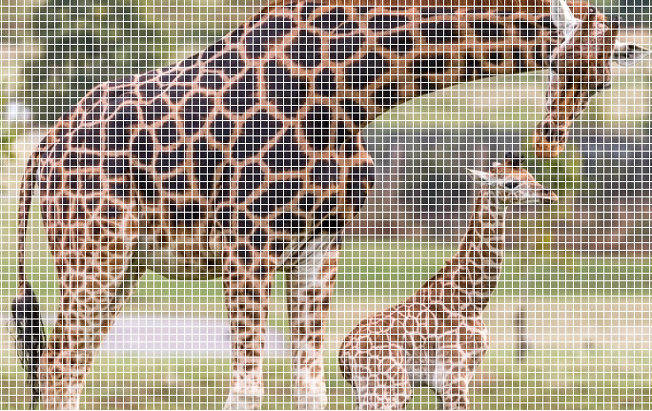
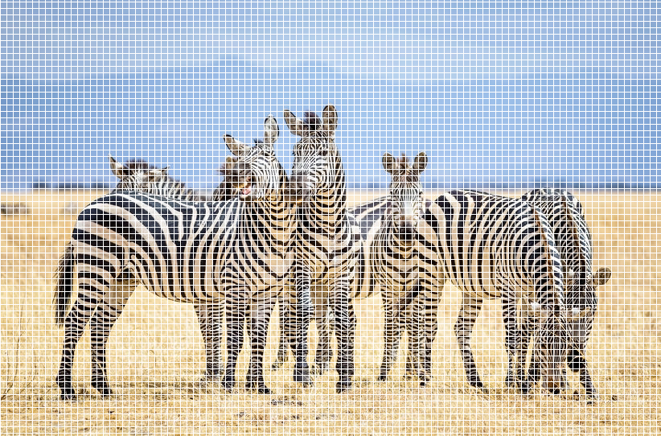
Visual Intuition
Slice into equally-sized chunks.

Slide 11
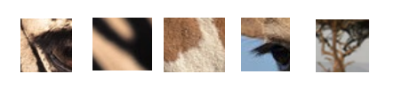
Build a codebook.
Codes will be averages of similar slices thanks to clustering.
They will still resemble common patterns.

Slide 12
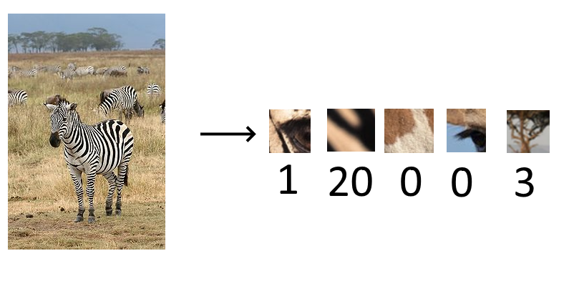
Train
Slice up a training sample, and build a histogram for collecting the slices’ nearest neighbors in the codebook.

Slide 13

Train
Train a classifier using the histogram as your feature vector.
1 | 20 | 0 | 0 | 3
-> Zebra

Slide 14
Notebook Demo
Adapted from CS 498, Applied Machine Learning, taught by Trevor Walker and developed by D. A. Forsyth. You can find the textbook for that course here(section 9.3)
We used the ADL dataset, available here.

Slide 15
Data Flow
1678 examples, 14 unique labels.
32Hz samples of accelerometer movement – 3 channels, variable length.
~38,000 slices of size 32 (32x3, flattened)
Feed into Kmeans -> 480 centroids in the codebook.
Slice training data for 3-fold validation. (1118 training examples).
Feed into nearest-neighbor using codebook. Histogram the centroids for each training example.
1118 histograms of length 480 with labels.
Train, then predict on remaining 539 validation examples and measure accuracy.

Slide 16
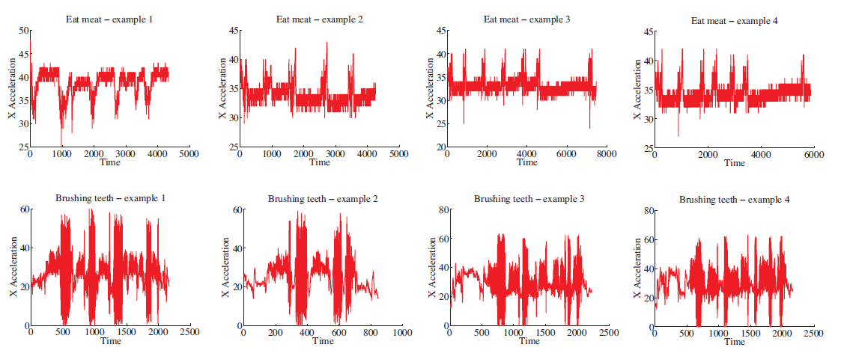
Accelerometer Data

Slide 17
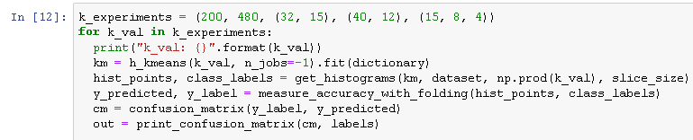
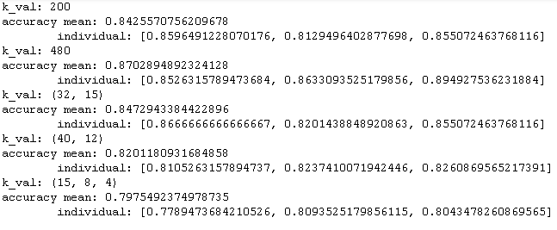
High Level Code / Results

Slide 18
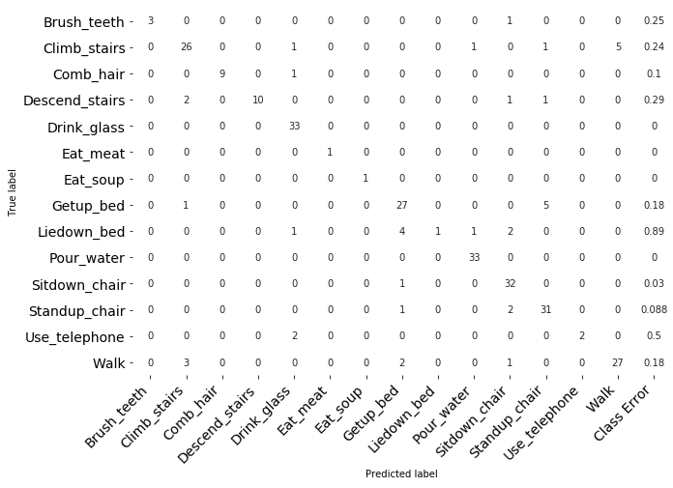
Confusion Matrix

Slide 19
Uses and Limitations
What do we lose in vector quantization?
What is it good for?
Where will it fail?
How can we tune it?

Slide 20
Hyperparameters
How you slice the data.
Overlap
Frame size
How you cluster the data for your codebook
“K” for k-means
Hierarchical or flat
Whatever parameters exist on your classifier

